Slide 1
Business letters

Slide 2
WHAT ARE BUSINESS LETTERS?
A business letter is a formal document often sent from one company to another or from a company to its clients, employees, and stakeholders, for example. Business letters are used for professional correspondence between individuals, as well.

Slide 3
Types of Business Letters
Positive
Negative

Slide 4
Positive Messages/letters:
Positive messages include messages where the audience is expected to react in a neutral to positive manner.
Positive messages tend to consist of routine or good news.
These messages might be items such as congratulations, confirmations, directions, simple credit requests, or credit approvals.

Slide 5
Consider the message to be a positive message structure when:
The receiver likes or expects this news (product shipped on time)
The receiver needs little education or background to understand the news (travel arrangement for the conference)
The receiver considers the message routine, even if not completely positive (parking lot closed for three days for new striping)

Slide 6
The three main parts of the positive news:
Main idea
Explanation
Motivation/polite closure

Slide 8
See example on page 87-88

Slide 9
NegativeMessages/Letters
Negative messages include messages where the audience is expected to react in a negative manner.
Negative messages consist of bad news. In these messages, the sender’s goal is to convey the bad news in a manner that preserves the business relationship. While the sender must deliver bad news, the sender wants to avoid an employee quitting or a customer finding another vendor.
These messages might be items such as refusal to provide a refund, cancellation of an event, inability to support an event and more.

Slide 10
Consider the message to be a negative communication when:
The receiver may be displeased (cost for repair is the receiver’s, not the utility company’s)
The receiver needs a little persuasion (new log-on procedure takes longer but is more secure)
The receiver may be somewhat uncomfortable (new badging system underway because employees have been sharing badges)

Slide 11
The four main parts of a negative news message:
Buffer or cushion
Explanation
Negative news
Redirect

Slide 13
Parts of the Negative News Message
Example
Buffer or Cushion
Thank you for your order. We appreciate your interest in our product.
Explanation
We are writing to let you know that this product has been unexpectedly popular, with over 10,000 requests on the day you placed your order.

Slide 14
Negative News
This unexpected increase in demand has resulted in a temporary out-of-stock/backorder situation. We will fulfill your order, received at 11:59 p.m. on 09/09/2009, in the order it was received.
Redirect
We anticipate that your product will ship next Monday. While you wait, we encourage you to consider using the enclosed $5 off coupon toward the purchase of any product in our catalog. We appreciate your business and want you to know that our highest priority is your satisfaction.

Slide 15
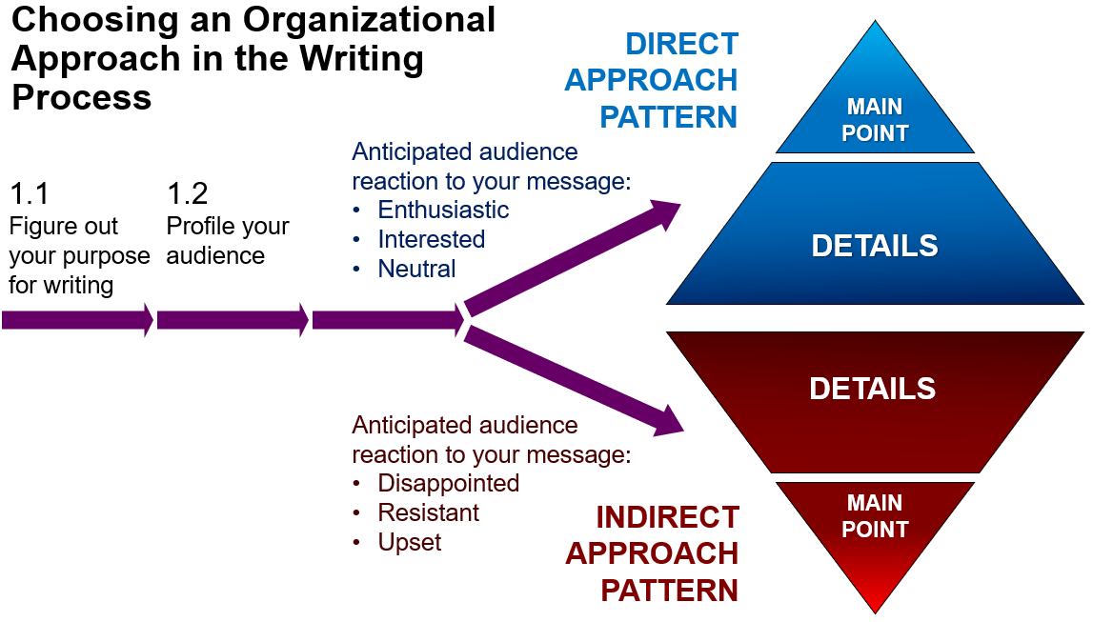

Slide 16
Essentials of Business Letters:
Developing Effective Tone: Business correspondence should have a tone that sounds natural and conveys cooperation, mutual respect, sincerity, and courtesy. Create a pleasant and cooperative tone in your correspondence.
Natural language: Use simple, clear, and natural language. Avoid using old-fashioned phrases that sound artificial.
Positive Language: Keep the emphasis on positive rather than negative images. Stress on the positive rather than negative aspects of a situation.

Slide 17
Negative: When I received your complaint, I checked our records.
Positive: When I received your letter, I checked our records.
Negative: I am sending a replacement for the faulty coil.
Positive: I am sending a new coil that is guaranteed for one year.
Negative: Do not let carelessness cause accidents in the testing laboratory.
Positive: Please be careful when handling explosive compounds.

Slide 18
You-Attitude: The you-attitude refers to the point of view a writer takes when looking at a situation as the reader would. Information is presented from the standpoint of how it will affect or interest your reader.
Writer Emphasis: We are shipping your order on Friday.
Reader Emphasis: You will receive your order by Monday.
Writer Emphasis: I was pleased to hear that the order was completed.
Reader Emphasis: Congratulations on successfully completing the project.

Slide 19
For you-attitude, do the following:
Emphasize reader’s benefits in a situation.
Be pleasant.
Offer a helpful suggestion or appreciative comment when possible.
Do not choose insulting or words for your readers.

Slide 20
Read example on pg 91

Slide 21
Letter format
Full Block Format
In a full block business letter, every component of the letter (heading, address, salutation, body, salutation, signature, identification, enclosures) is aligned to the left. Also, first sentences of paragraphs are not indented.
You will see that there are two spaces between the address and the date; three spaces between the address and the salutation; two spaces between the salutation and the first body paragraph; two spaces between first, second, and third body paragraphs; two spaces between the body, the complimentary close, the signature line, identification, and enclosures.

Slide 22
See the format on pg 92-93

Slide 23
Read the tips on pg 93

Slide 24
Practice exercise
Sales have decreased for two consecutive quarters at your business. You have been instructed to inform your sales team that their hours, and base pay, will be reduced by 20 percent. While you may have a few members of your sales team that are underperforming, you want to retain the entire team. Write a negative news message in a direct or indirect approach informing your sales team of the news.
You have observed and documented an employee being late and taking long breaks for the past two weeks. Write out a brief summary of the conversation you need to have. You may be assigned to another classmate for a role-playing exercise. Share and compare with your classmates.
Write a follow-up letter thanking a customer for his or her business. The letter should be brief, direct, and courteous.
Write a letter of application to a company that has advertised an opening for a job that interests you. Clearly state your interest and qualifications. Be brief and to the point. Be sure to proofread the letter carefully and correct any careless errors.

